Slide 1



























Conceptual Analysis of the Centipede Paradox and its Practical Resolution by M. Kaneko & R. Ishikawa, 09 April 2024
1) The centipede game with $n=100$.
2) The paradox is an antagonism between the (seemingly) well founded theory (BI theory) and its implication strange from practical point of view.
3) We conduct a conceptual study of the centipede paradox. Does the BI theory include drawbacks?
4) Our study leads to a practical recommendation such as $c^{ℓ}∙d^{100−ℓ}$ ($ℓ≤2)$. In what sense?
1
2
1
2
$$x_{1}$$
$$x_{2}$$
$$x_{3}$$
$$x_{4}$$
$$x_{5}$$
$$∙ ∙ ∙$$
$$c$$
$$x_{100}$$
$$c$$
$$∙ ∙ ∙$$
$$x_{99}$$
$$c$$
$$z_{101}$$
$$G_{100}$$
(202,202)
$$d$$
$$d$$
$$z_{2}$$
$$z_{4}$$
$$z_{5}$$
$$∙ ∙ ∙$$
$$z_{99}$$
$$z_{1}$$
$$z_{3}$$
$$z_{100}$$
(2$,2$)
(1,7)
(6,6)
(5,11)
(10,10)
$$∙ ∙ ∙$$
(198,198)
(197,203)

Slide 2
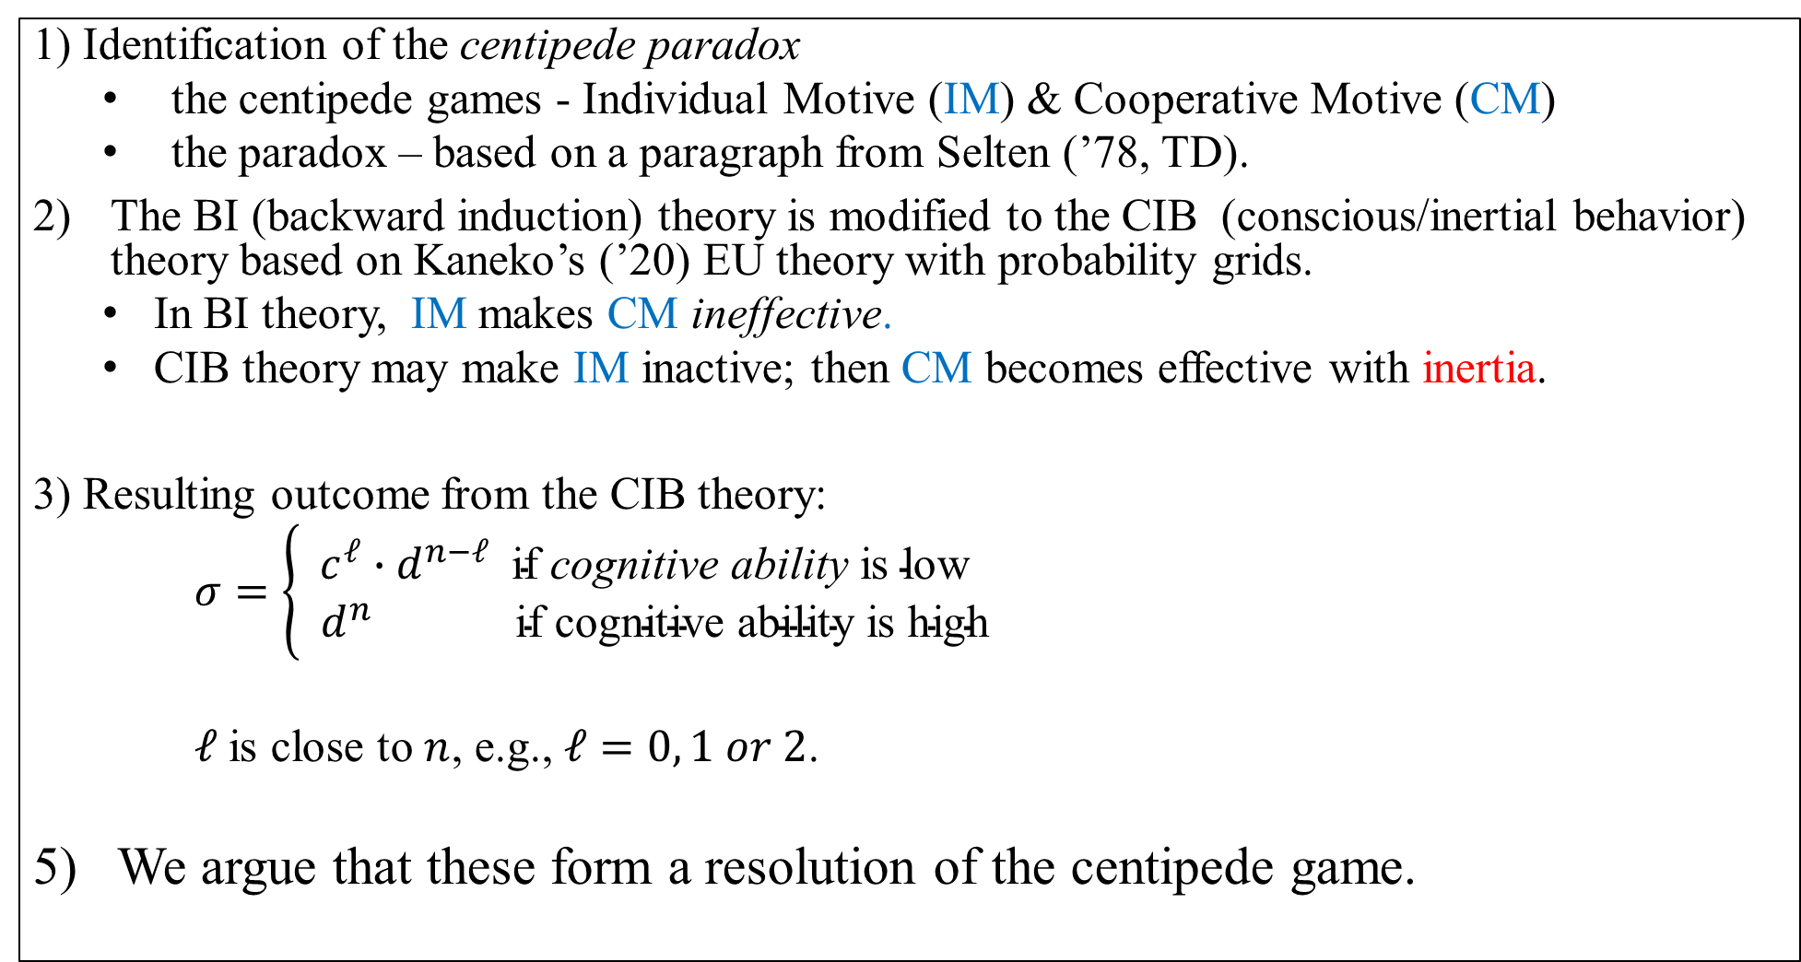
1) Identification of the centipede paradox
  the centipede games - Individual Motive (IM) & Cooperative Motive (CM)
  the paradox – based on a paragraph from Selten (’78, TD).
The BI (backward induction) theory is modified to the CIB (conscious/inertial behavior) theory based on Kaneko’s (’20) EU theory with probability grids.
  In BI theory, IM makes CM ineffective.
  CIB theory may make IM inactive; then CM becomes effective with inertia.
3) Resulting outcome from the CIB theory:
$σ=\left\{\begin{aligned}c^{ℓ}∙d^{n−ℓ} \text{if} \text{cognitive} \text{ability} \text{is} \text{low} \\ d^{n} \text{if} \text{cognitive} \text{ability} \text{is} \text{high}\end{aligned}\right.$
  $ℓ$is close to $n$, e.g., $ℓ=0, 1 or 2$.
5) We argue that these form a resolution of the centipede game.

Slide 3
Selten (‘78), 132-133: Chain-Store Paradox
(*) ... If I had to play the game in the role of the chain-store,
I would follow deterrence theory, …
I get the impression that most people share this inclination.
My experiences suggest that mathematically trained persons
recognize the logical validity of the induction argument,
but they refuse to accept it as a guide to practical behavior.
He explains the BI argument to his people
They are mathematical trained people
How does he explain his theory to them?
The full theory? Or an algorithm?
iv. But they are not “completely rational people”, but yet ordinary people

Slide 4
Questions:
Q-o: What are the classes of centipede games and variants?
Some hints may be hidden?
Q-i: What is the conceptual bases of the BI theory? What are wrong?
Two bases are wrong.
Q-ii: What is our modification, the CIB theory, of the BI theory?
The above two are weakened.
Q-iii: Is Selten's question about refusal of the BI theory meaningful?
How about the CIB theory?
A drawback suggested in Q-i nullifies his question.
Q-iv: How do we evaluate the resulting outcomes?

Slide 5
Q-o:
P1 (Indi. Mo.)
P2 (Coop. Mo.)
only P1 is effective
Centipede Game
nullified by P1
Incom.
Inertia
P1 is partial
P2 revives
Q-i:
P1 (Com. Compara.)
P2 (For. Bygones)
CIB
Q-ii
weakened
CIB sol. $c^{ℓ}∙d^{n−ℓ}$ with $ℓ=$ $ℓ(n)$
Explanation of $c^{ℓ}∙d^{n−ℓ}$by the behavioral algorithm with the oracle
Q-iii
Incidentally, P1 makes Selten’s question about practical behavior almost empty
Q-iv
Is behavioral divide $ℓ(n)$ small such as 0,1,2?
Yes, it is. O2 is satisfied
This tendency is confirmed in CIB

Slide 6

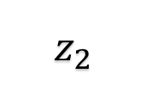












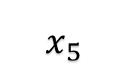










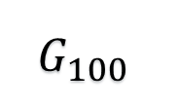
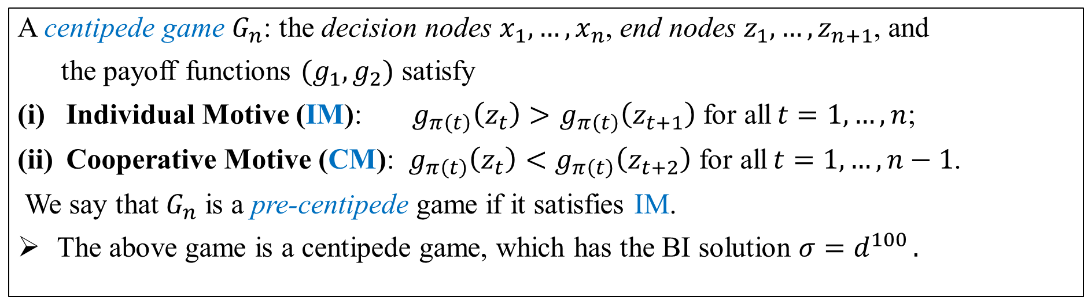
Identification of the centipede games
1
$$∙ ∙ ∙$$
1
2
2
$$x_{100}$$
$$x_{1}$$
$$x_{2}$$
$$x_{3}$$
$$x_{4}$$
$$x_{5}$$
$$x_{99}$$
$$c$$
$$c$$
$$c$$
$$∙ ∙ ∙$$
$$z_{101}$$
$$G_{100}$$
(202,202)
$$d$$
$$d$$
$$z_{2}$$
$$z_{4}$$
$$z_{5}$$
$$∙ ∙ ∙$$
$$z_{99}$$
$$z_{1}$$
$$z_{3}$$
$$z_{100}$$
(2$,2$)
(1,7)
(6,6)
(5,11)
(10,10)
$$∙ ∙ ∙$$
(198,198)
(197,203)
A centipede game $G_{n}$: the decision nodes $x_{1},…, x_{n}$, end nodes $z_{1},…, z_{n+1}$, and
the payoff functions $(g_{1},g_{2})$ satisfy
Individual Motive (IM): $g_{π\left(t\right)}\left(z_{t}\right)>$ $g_{π\left(t\right)}\left(z_{t+1}\right)$ for all$t=1,…,n$;
Cooperative Motive (CM): $g_{π\left(t\right)}\left(z_{t}\right)<$ $g_{π\left(t\right)}\left(z_{t+2}\right)$ for all$t=1,…,n−1$.
We say that $G_{n}$ is a pre-centipede game if it satisfies IM.
The above game is a centipede game, which has the BI solution $σ=d^{100 }.$

Slide 7
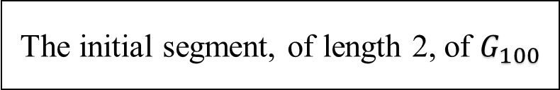
Centipede and pre-centipede games
The initial segment, of length 2, of $G_{100}$
The above is an sk-convex centipede game
IM is quickly increasing;
CM is effective only in the beginning of the game, but IM is dominant later.
We focus on the class of sk-linear and sk-concave centipede games.
Pre-centipede games without CM

Slide 8
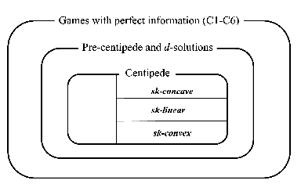
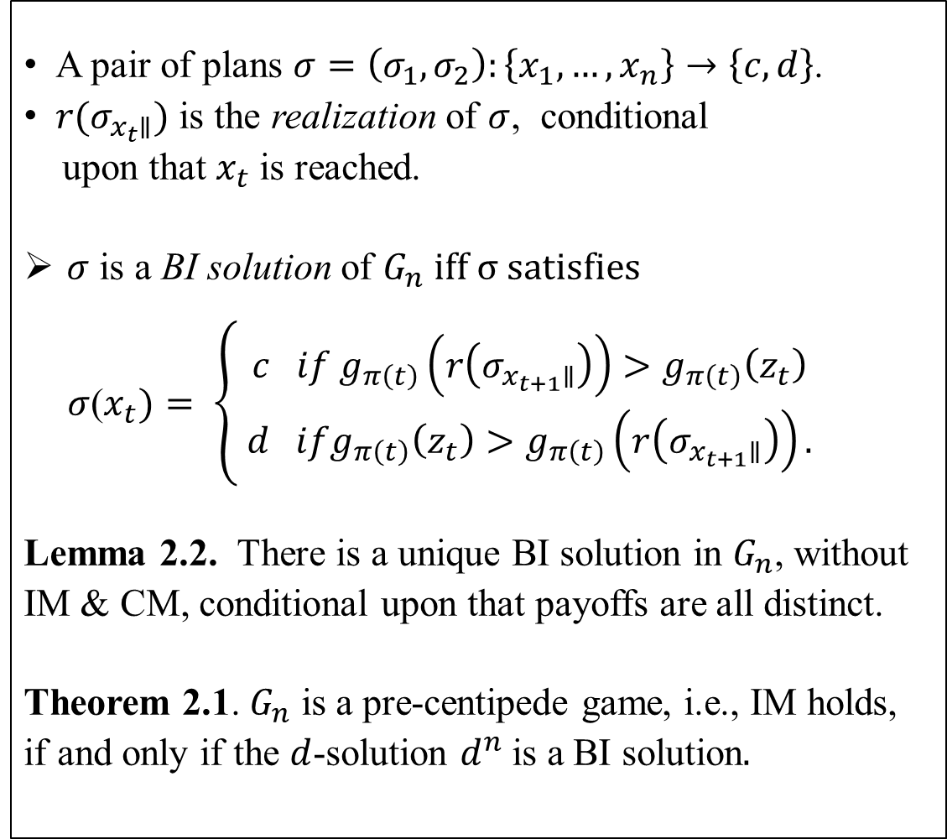
BI solutions
A pair of plans $σ=\left(σ_{1},σ_{2}\right):\left\{x_{1},…,x_{n}\right\}→\left\{c,d\right\}$.
$r(σ_{x_{t}∥})$ is the realization of $σ$, conditional
upon that $x_{t}$is reached.
$σ$ is a BI solution of $G_{n} iff σ satisfies$
$σ$($x_{t})= \left\{\begin{aligned} c if g_{π\left(t\right)}\left(r\left(σ_{x_{t+1}∥}\right)\right)>g_{π\left(t\right)}\left(z_{t}\right) \\ d ifg_{π\left(t\right)}\left(z_{t}\right)>g_{π\left(t\right)}\left(r\left(σ_{x_{t+1}∥}\right)\right).\end{aligned}\right.$
Lemma 2.2. There is a unique BI solution in $G_{n}$, without
IM & CM, conditional upon that payoffs are all distinct.
Theorem 2.1. $G_{n}$ is a pre-centipede game, i.e., IM holds,
if and only if the $d$-solution $d^{n}$is a BI solution$.$
C1-C5

Slide 9
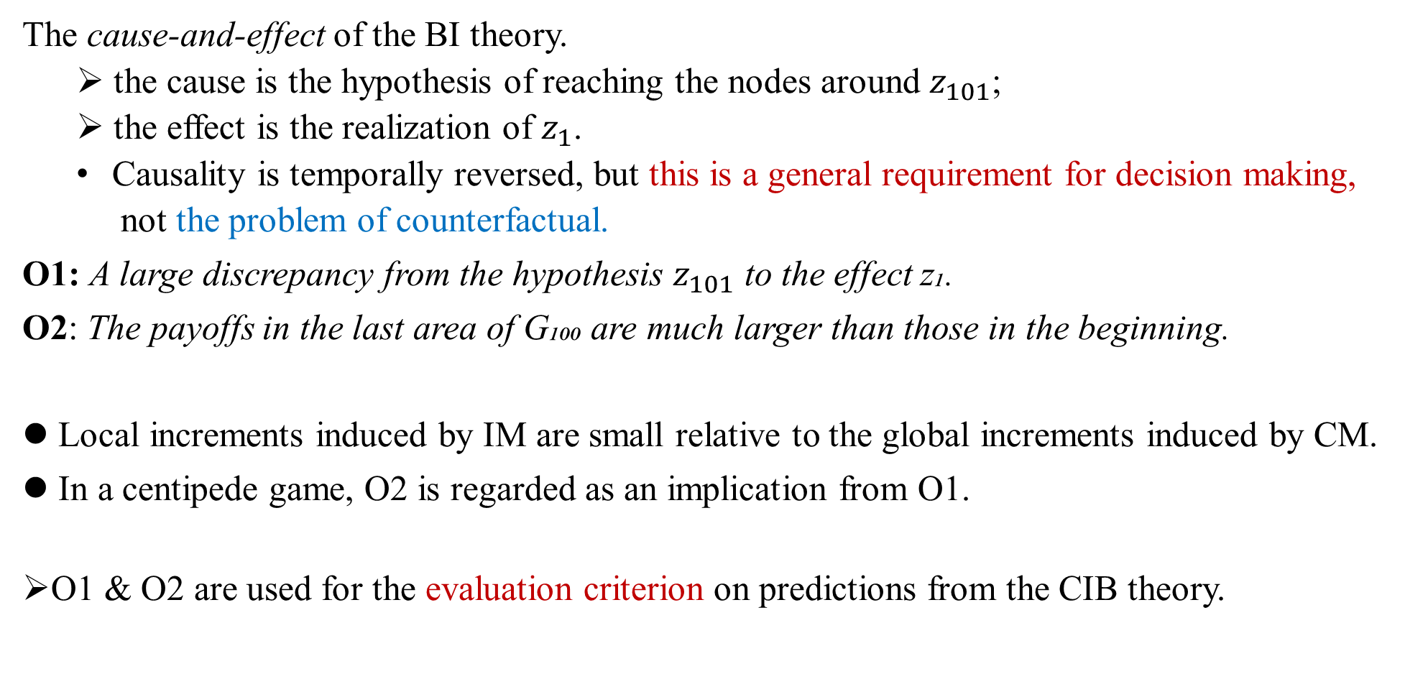
Reason for Selten people’s response in the centipede game
The cause-and-effect of the BI theory.
  the cause is the hypothesis of reaching the nodes around $z_{101}$;
  the effect is the realization of $z_{1}$.
  Causality is temporally reversed, but this is a general requirement for decision making,
  not the problem of counterfactual.
O1: A large discrepancy from the hypothesis $z_{101}$ to the effect z₁.
O2: The payoffs in the last area of G₁₀₀ are much larger than those in the beginning.
Local increments induced by IM are small relative to the global increments induced by CM.
In a centipede game, O2 is regarded as an implication from O1.
O1 & O2 are used for the evaluation criterion on predictions from the CIB theory.

Slide 10
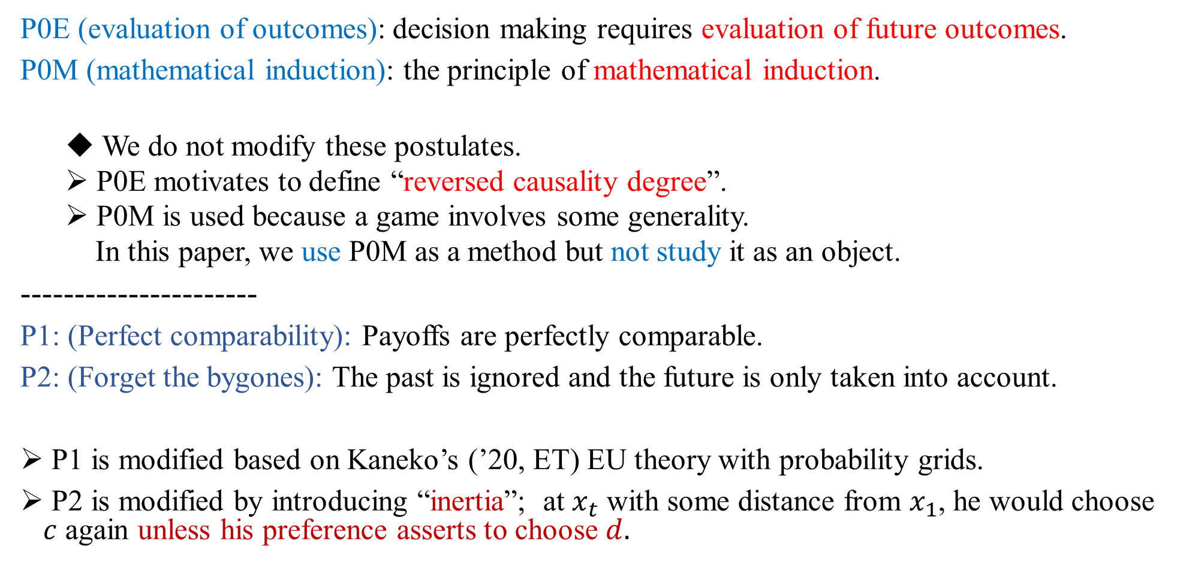
2): Conceptual bases of the BI theory
P0E (evaluation of outcomes): decision making requires evaluation of future outcomes.
P0M (mathematical induction): the principle of mathematical induction.
  We do not modify these postulates.
  P0E motivates to define “reversed causality degree”.
  P0M is used because a game involves some generality.
  In this paper, we use P0M as a method but not study it as an object.
----------------------
P1: (Perfect comparability): Payoffs are perfectly comparable.
P2: (Forget the bygones): The past is ignored and the future is only taken into account.
P1 is modified based on Kaneko’s (’20, ET) EU theory with probability grids.
P2 is modified by introducing “inertia”; at $x_{t}$ with some distance from $x_{1}$, he would choose $c$ again unless his preference asserts to choose $d.$

Slide 11
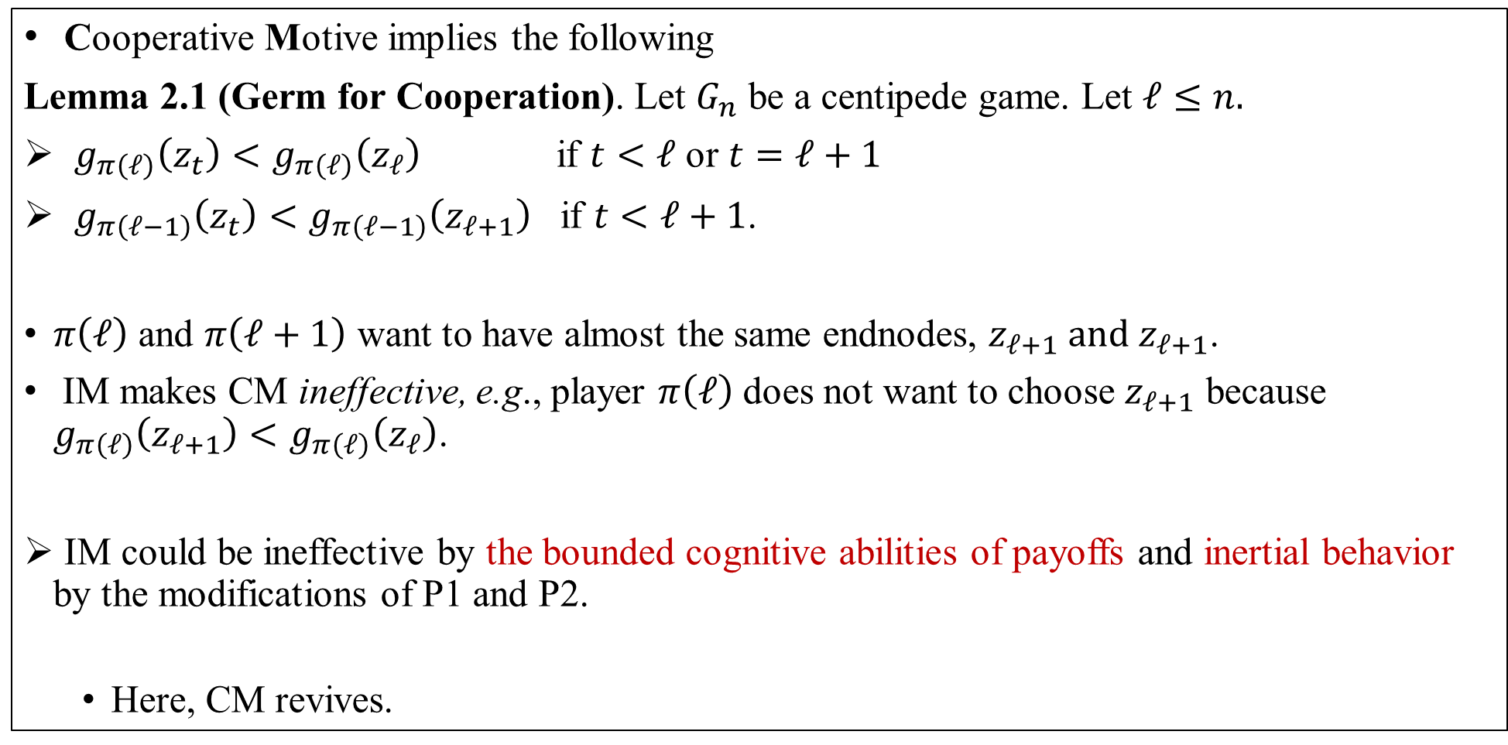
Wishful thinking in a centipede game
Cooperative Motive implies the following
Lemma 2.1 (Germ for Cooperation). Let $G_{n}$ be a centipede game. Let $ℓ≤n.$
$g_{π\left(ℓ\right)}\left(z_{t}\right)<g_{π\left(ℓ\right)}\left(z_{ℓ}\right)$ if $t<ℓ$ or $t=ℓ+1$
$g_{π\left(ℓ−1\right)}\left(z_{t}\right)<g_{π\left(ℓ−1\right)}\left(z_{ℓ+1}\right)$ if $t<ℓ+1$.
$π\left(ℓ\right)$ and $π\left(ℓ+1\right)$ want to have almost the same endnodes, ${z_{ℓ+1} and z}_{ℓ+1}$.
IM makes CM ineffective, e.g., player $π\left(ℓ\right)$ does not want to choose $z_{ℓ+1}$ because $g_{π\left(ℓ\right)}\left(z_{ℓ+1}\right)<g_{π\left(ℓ\right)}\left(z_{ℓ}\right)$.
IM could be ineffective by the bounded cognitive abilities of payoffs and inertial behavior by the modifications of P1 and P2.
  Here, CM revives.

Slide 12

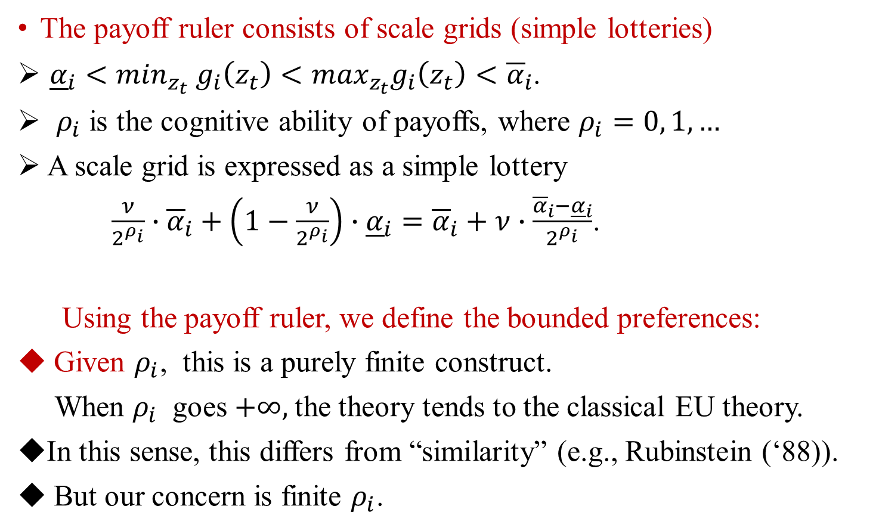


EU Theory with probability grids
Payoffs
$$z_{t′′}$$
The payoff ruler consists of scale grids (simple lotteries)
${\underline{α}}_{i}<\min_{z_{t}} g_{i}\left(z_{t}\right)<\max_{z_{t}}g_{i}\left(z_{t}\right)$ $<{\overline{α}}_{i}$.
$ρ_{i}$ is the cognitive ability of payoffs, where $ρ_{i}=0, 1,…$
A scale grid is expressed as a simple lottery
$\frac{ν}{2^{ρ_{i}}}∙{\overline{α}}_{i}+\left(1−\frac{ν}{2^{ρ_{i}}}\right)∙{\underline{α}}_{i}={\overline{α}}_{i}+ν∙\frac{{\overline{α}}_{i}−{\underline{α}}_{i}}{2^{ρ_{i}}}$.
Using the payoff ruler, we define the bounded preferences:
Given $ρ_{i}$, this is a purely finite construct.
When $ρ_{i}$ goes $+∞,$the theory tends to the classical EU theory.
In this sense, this differs from “similarity” (e.g., Rubinstein (‘88)).
But our concern is finite $ρ_{i}$.
$$z_{t′}$$
$$z_{t}$$
Payoff ruler

Slide 13

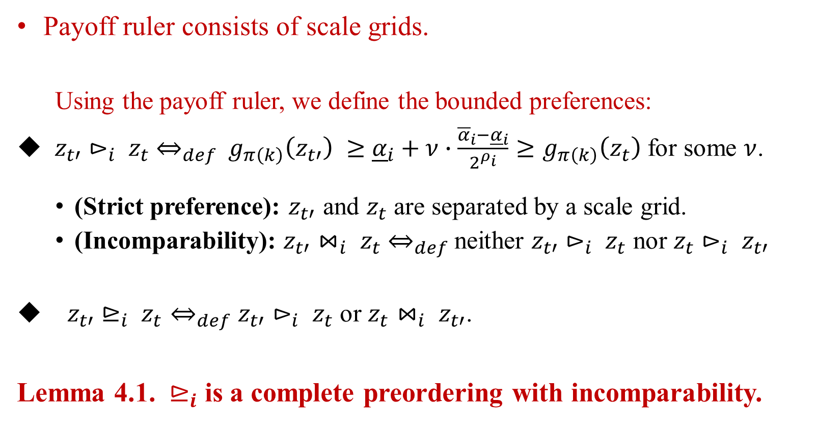


3): From the BI theory to the CIB (conscious/inertial behavior) theory
Payoffs
$$z_{t′′}$$
Payoff ruler consists of scale grids.
  Using the payoff ruler, we define the bounded preferences:
$z_{t′}⊳_{i} z_{t}$ $⇔_{def}$ $g_{π\left(k\right)}\left(z_{t′}\right) ≥$ ${\underline{α}}_{i}+ν∙\frac{{\overline{α}}_{i}−{\underline{α}}_{i}}{2^{ρ_{i}}}≥$ $g_{π\left(k\right)}\left(z_{t}\right)$for some $ν$.
  (Strict preference): $z_{t′}$ and $z_{t}$ are separated by a scale grid.
  (Incomparability): $z_{t′}⋈_{i} z_{t}$ $⇔_{def}$neither $z_{t′}⊳_{i} z_{t}$ nor $z_{t}⊳_{i} z_{t′}$
$z_{t′}⊵_{i} z_{t}⇔_{def}z_{t′}⊳_{i} z_{t}$ or $z_{t}⋈_{i} z_{t′}$.
Lemma 4.1. $⊵_{i}$ is a complete preordering with incomparability.
$$z_{t′}$$
$$z_{t}$$
Payoff ruler

Slide 14
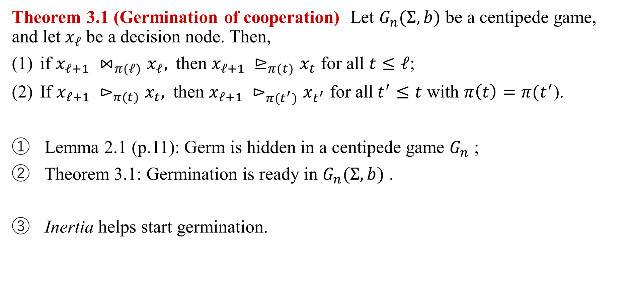
Theorem 3.1 (Germination of cooperation) Let $G_{n}(Σ,b)$ be a centipede game, and let $x_{ℓ}$be a decision node. Then,
if $x_{ℓ+1} {⋈_{π(ℓ)}x}_{ℓ},$then $x_{ℓ+1} {⊵_{π(t)}x}_{t}$ for all $t≤$ $ℓ$;
If $x_{ℓ+1} {⊳_{π(t)}x}_{t},$then $x_{ℓ+1} {⊳_{π(t^{′})}x}_{t^{′}}$ for all$t^{′}≤$ $t$ with $π\left(t\right)=π(t^{′}$).
Lemma 2.1 (p.11): Germ is hidden in a centipede game $G_{n}$ ;
Theorem 3.1: Germination is ready in $G_{n}(Σ,b)$ .
Inertia helps start germination.

Slide 15

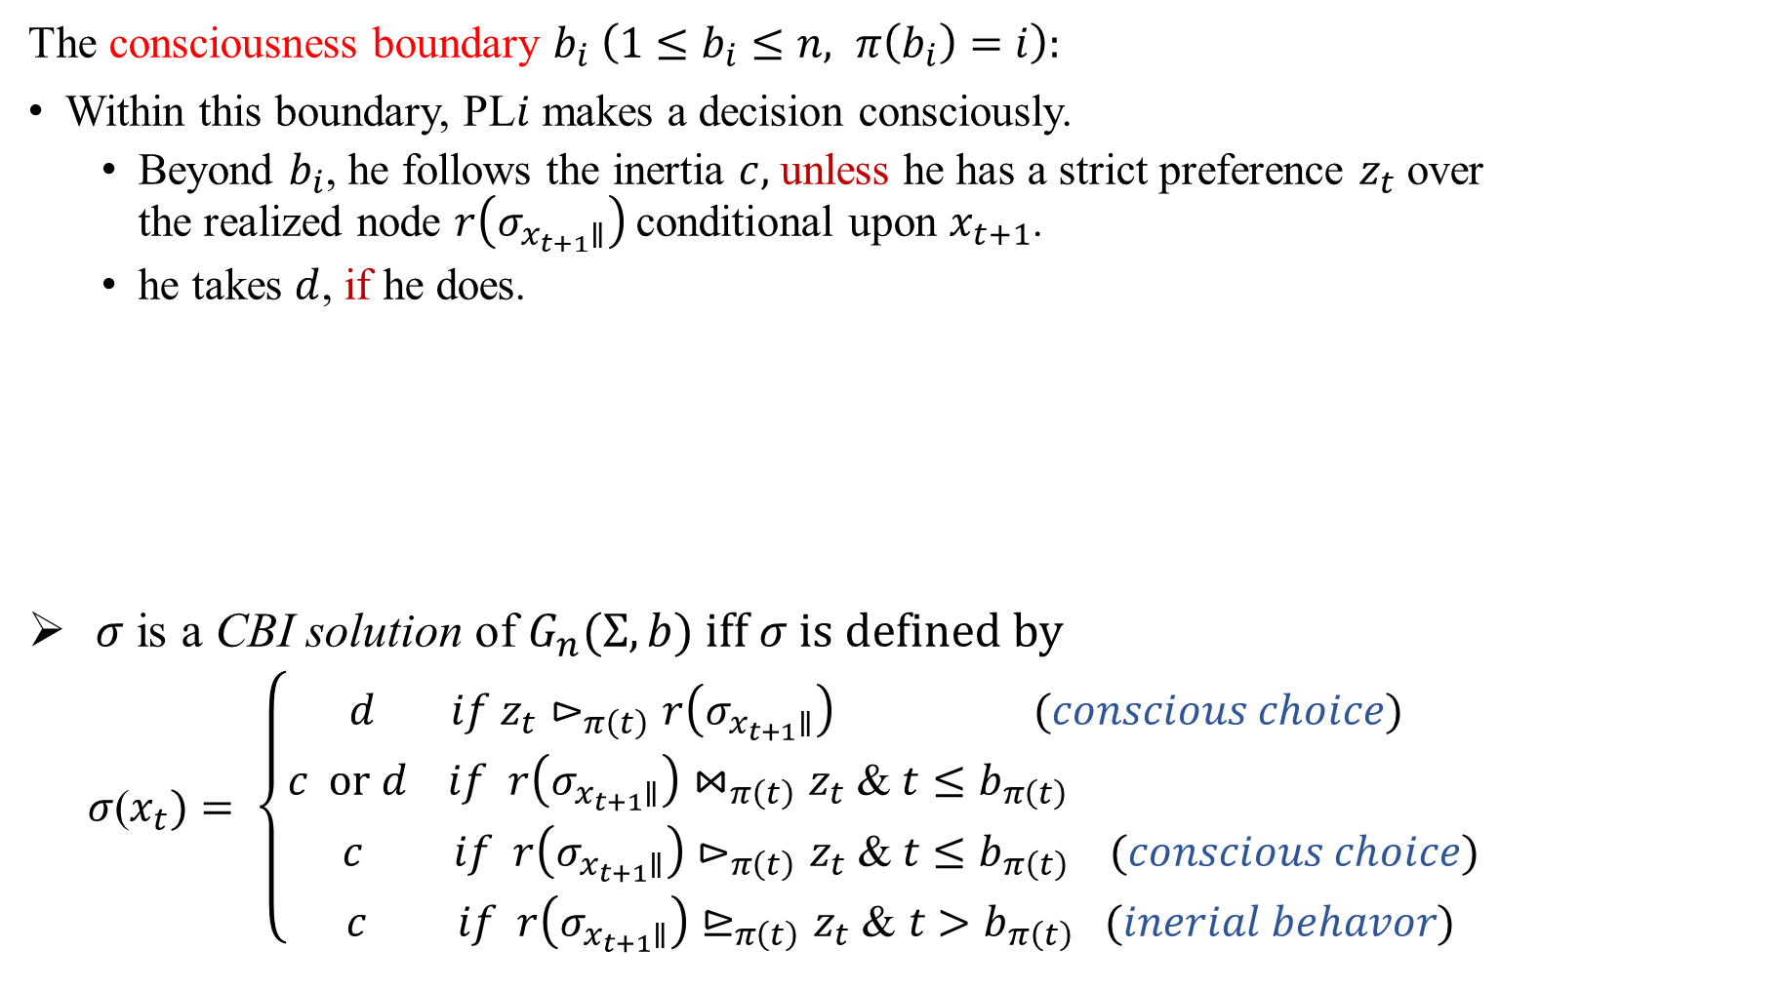


The CIB theory
The consciousness boundary $b_{i} \left(1≤b_{i}≤n, π\left(b_{i}\right)=i\right):$
Within this boundary, PL$i$ makes a decision consciously.
  Beyond $b_{i}$, he follows the inertia $c,$ unless he has a strict preference $z_{t}$over the realized node $r\left(σ_{x_{t+1}∥}\right)$ conditional upon $x_{t+1}$.
  he takes $d$, if he does.
$σ$ is a CBI solution of $G_{n}(Σ,b) iff σ is defined by$
$σ$($x_{t})= \left\{\begin{aligned} \\ d if{ z}_{t}⊳_{π\left(t\right)}r\left(σ_{x_{t+1}∥}\right) (conscious choice) \\ c or d if r\left(σ_{x_{t+1}∥}\right)⋈_{π\left(t\right)}z_{t} \text{&} t≤b_{π\left(t\right)} \\ c if r\left(σ_{x_{t+1}∥}\right)⊳_{π\left(t\right)}z_{t} \text{&} t≤b_{π\left(t\right)} (conscious choice) \\ c if r\left(σ_{x_{t+1}∥}\right)⊵_{π\left(t\right)}z_{t} \text{&} t>b_{π\left(t\right)} (inerial behavor)\end{aligned} \right.$
conscious
Inertial without new stimulus
$$x_{1}$$
$x_{b_{π(t)}}$
$$x_{100}$$

Slide 16
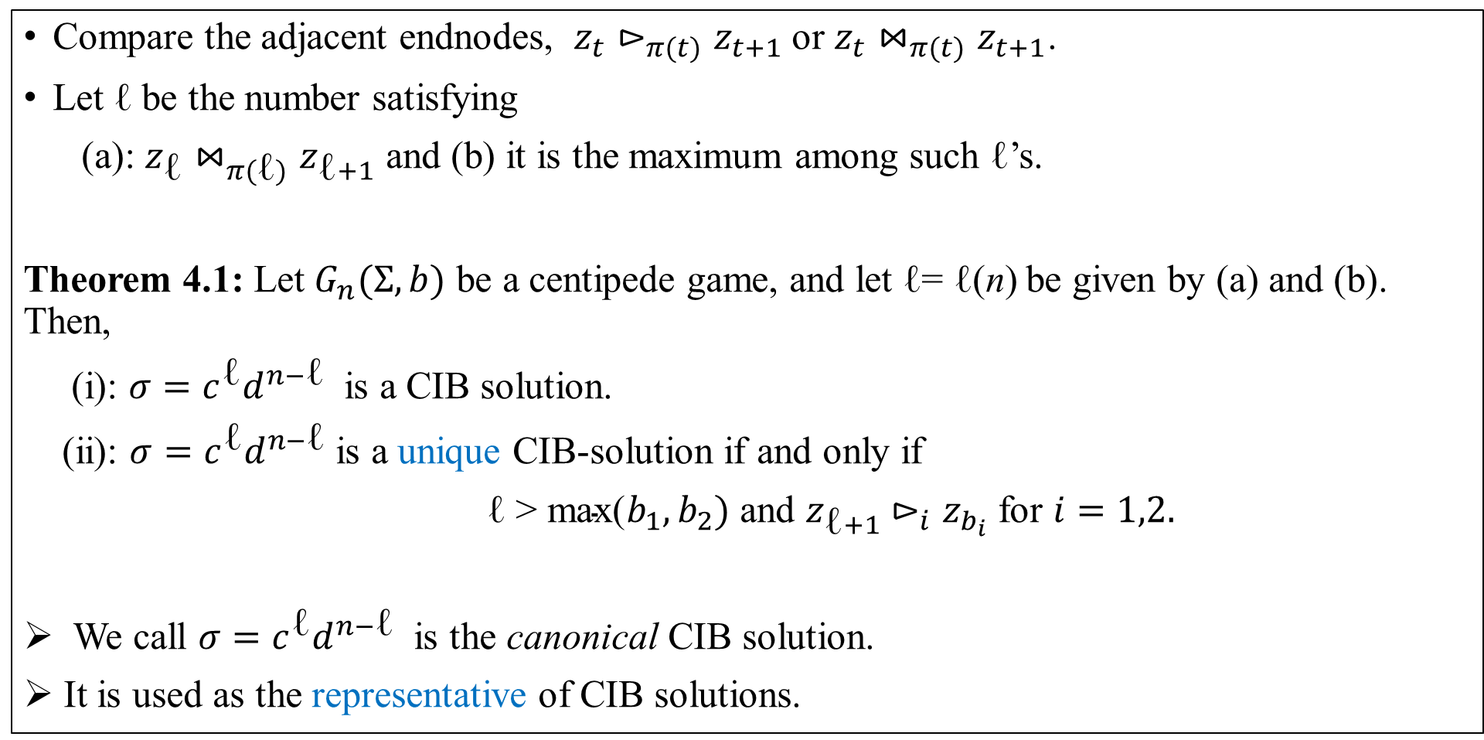
Canonical CIB solution
Compare the adjacent endnodes, $z_{t}⊳_{π(t)}z_{t+1}$ or $z_{t}⋈_{π(t)}z_{t+1}$.
Let $\text{ℓ}$be the number satisfying
(a): $z_{\text{ℓ}}⋈_{π(\text{ℓ})}z_{\text{ℓ}+1}$ and (b) it is the maximum among such $\text{ℓ}$’s.
Theorem 4.1: Let $G_{n}(Σ,b)$ be a centipede game, and let $\text{ℓ}\text{= ℓ(}\text{n}\text{)}$ be given by (a) and (b). Then,
(i): $σ=c^{\text{ℓ}}d^{n−\text{ℓ}}$ is a CIB solution.
(ii): $σ=c^{\text{ℓ}}d^{n−\text{ℓ}}$ is a unique CIB-solution if and only if
$\text{ℓ > }\text{max}\text{(}b_{1},b_{2})$ and $z_{\text{ℓ}+1}$ $⊳_{i}z_{b_{i}}$ for $i=1,2.$
We call $σ=c^{\text{ℓ}}d^{n−\text{ℓ}}$ is the canonical CIB solution.
It is used as the representative of CIB solutions.

Slide 17








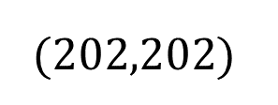




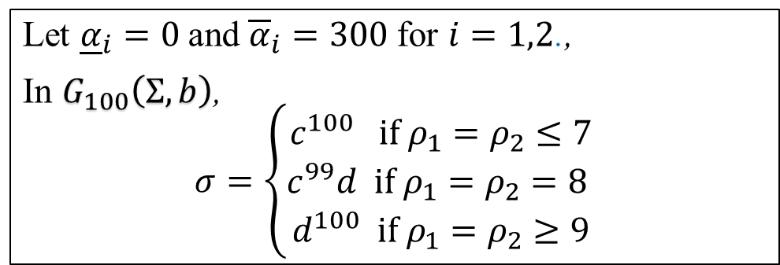





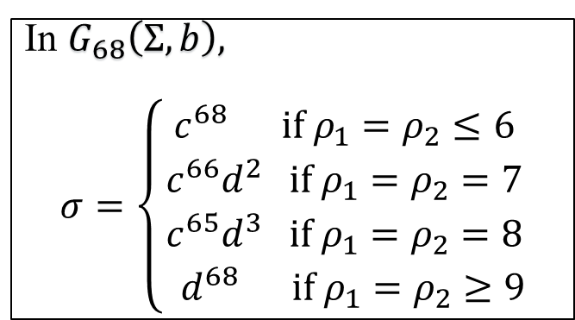
What are the canonical CIB solution?
1
$$∙ ∙ ∙$$
1
2
2
$$x_{100}$$
$$x_{1}$$
$$x_{2}$$
$$x_{3}$$
$$x_{4}$$
$$x_{5}$$
$$x_{99}$$
$$c$$
$$c$$
$$c$$
$$∙ ∙ ∙$$
$$z_{101}$$
$$G_{100}$$
$$(202,202)$$
$$d$$
$$d$$
$$z_{2}$$
$$z_{4}$$
$$z_{5}$$
$$∙ ∙ ∙$$
$$z_{99}$$
$$z_{1}$$
$$z_{3}$$
$$z_{100}$$
(2$,2$)
(1,7)
(6,6)
(5,11)
(10,10)
$$∙ ∙ ∙$$
(198,198)
(197,203)
Let ${\underline{α}}_{i}=0$and ${\overline{α}}_{i}=300$for $i=1,2$.,
In $G_{100}\left(Σ,b\right)$,
$$σ=\left\{\begin{aligned}c^{100} if ρ_{1}=ρ_{2}≤7 \\ c^{99}d if ρ_{1}=ρ_{2}=8 \\ d^{100} if ρ_{1}=ρ_{2}≥9\end{aligned}\right.$$
In $G_{68}\left(Σ,b\right),$
$$σ=\left\{\begin{aligned}c^{68} if ρ_{1}=ρ_{2}≤6 \\ c^{66}d^{2} if ρ_{1}=ρ_{2}=7 \\ c^{65}d^{3} if ρ_{1}=ρ_{2}=8 \\ { d}^{68} if ρ_{1}=ρ_{2}≥9\end{aligned}\right.$$
Strong tendencies for cooperation for low cognitive abilities;
d-solution for high cognitive abilities.
Are the above examples typical? - - more examples and results in the paper.

Slide 18
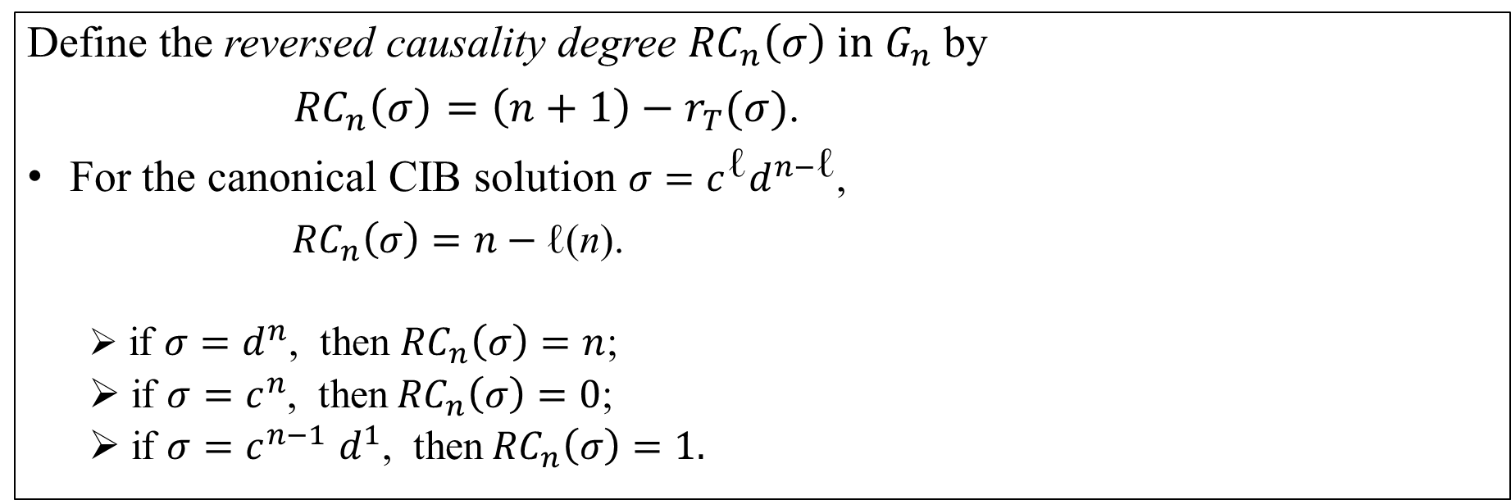
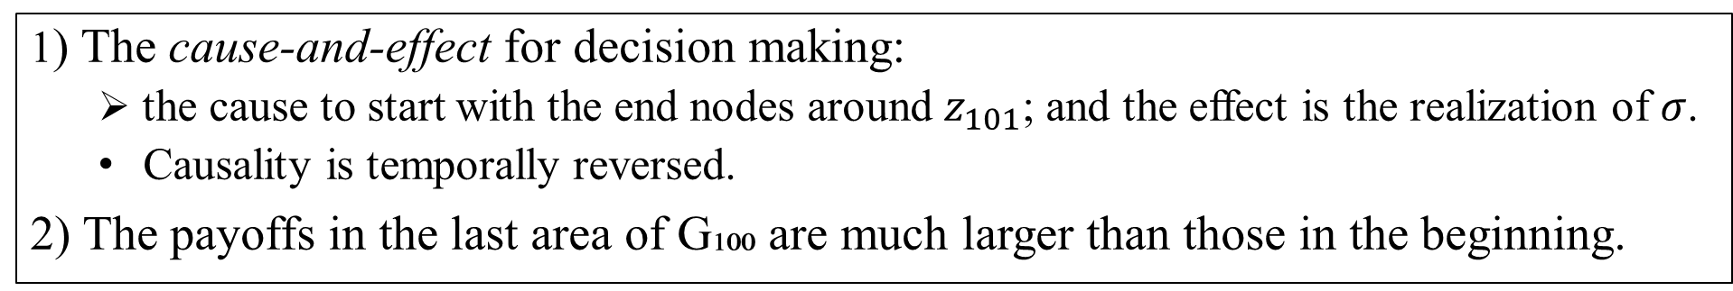
Selten people’s response and the reversed causality degree
1) The cause-and-effect for decision making:
  the cause to start with the end nodes around $z_{101}$; and the effect is the realization of $σ$.
  Causality is temporally reversed.
2) The payoffs in the last area of G₁₀₀ are much larger than those in the beginning.
Define the reversed causality degree ${RC}_{n}\left(σ\right) in G_{n}$ by
${RC}_{n}\left(σ\right)=\left(n+1\right)−r_{T}(σ)$.
For the canonical CIB solution $σ=c^{\text{ℓ}}d^{n−\text{ℓ}}$,
${RC}_{n}\left(σ\right)=n−\text{ℓ(}\text{n}\text{)}$.
  if $σ=d^{n}$, then ${RC}_{n}\left(σ\right)=n$;
  if $σ=c^{n}$, then${ RC}_{n}\left(σ\right)=0$;
  if $σ=c^{n−1}$ $d^{1}$, then${RC}_{n}\left(σ\right)=1.$

Slide 19
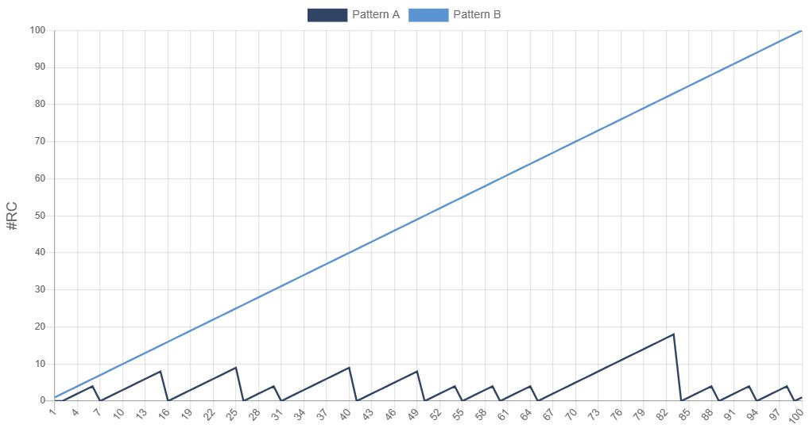
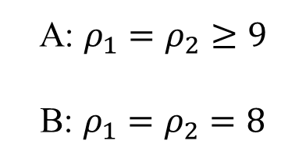

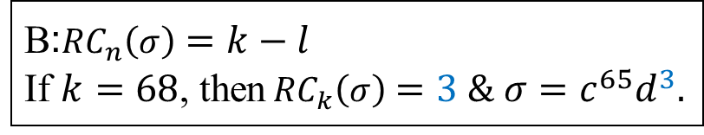
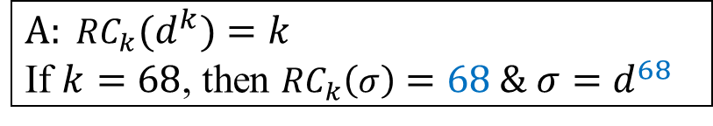
${RC}_{k}\left(σ\right)=k−\text{ℓ}$ $in G_{k}(Σ,b)$ for $σ=$ $c^{\text{ℓ}}d^{k−\text{ℓ}}, k=1,…,n$
$$A: {{RC}_{k}(d}^{k})=k$$
If $k=68$, then ${RC}_{k}\left(σ\right)=68 \& σ=d^{68}$
A: $ρ_{1}=ρ_{2}≥9$
B: $ρ_{1}=ρ_{2}=8$
B:${RC}_{n}\left(σ\right)=k−l$
If $k=68$, then${RC}_{k}\left(σ\right)=3 \& σ=c^{65}d^{3}.$
$$k$$

Slide 20
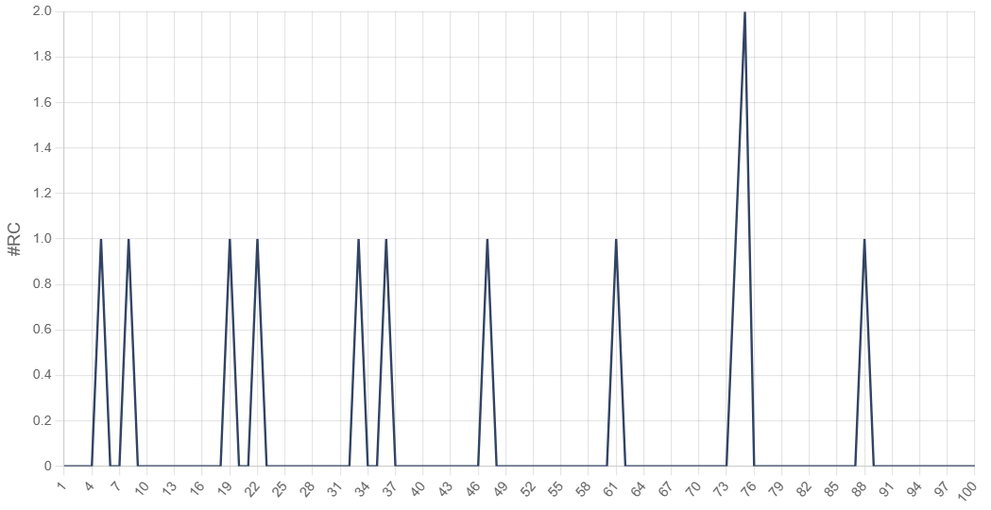
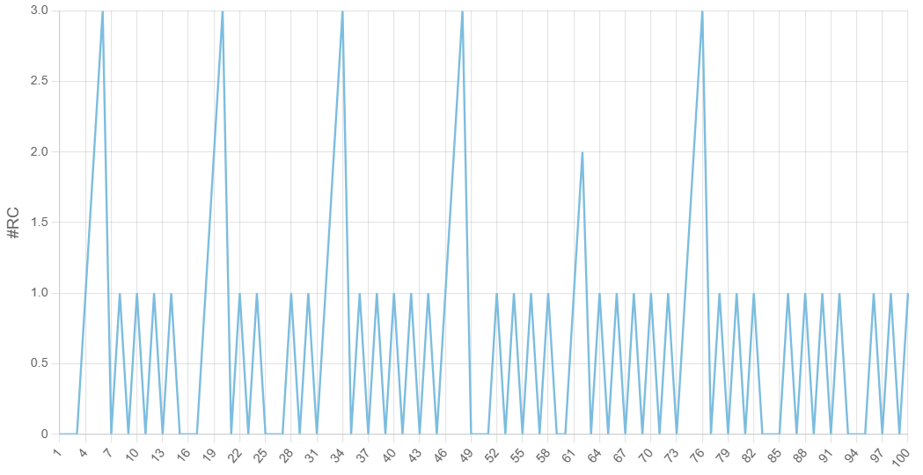


${RC}_{k}\left(σ\right)=k−\text{ℓ}$ $in G_{k}(Σ,b)$ for $σ=$ $c^{\text{ℓ}}d^{k−\text{ℓ}}, k=1,…,100$
$ρ_{1}=ρ_{2}=5$
$ρ_{1}=5 ρ_{2}=8$

Slide 21
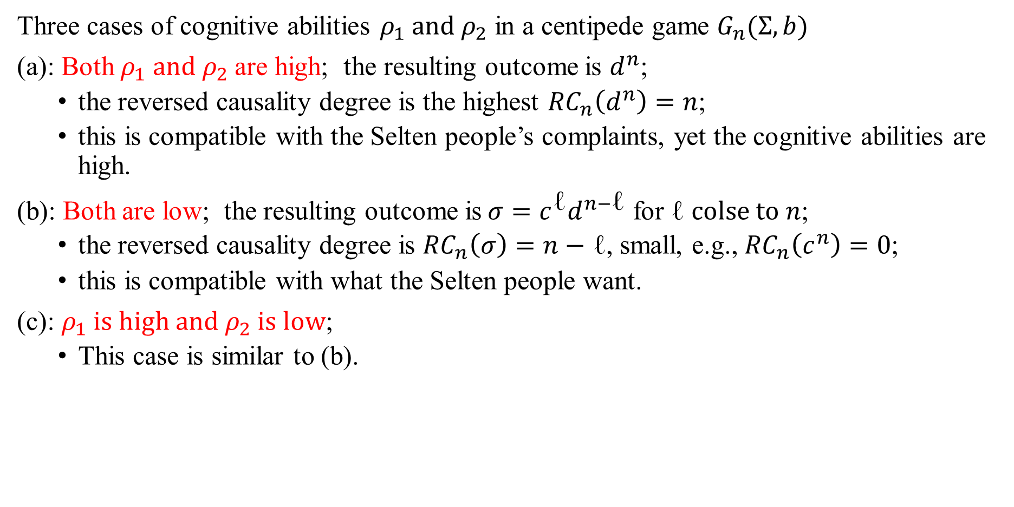
Summary of the calculation results
Three cases of cognitive abilities $ρ_{1} and{ ρ}_{2}$ in a centipede game $G_{n}(Σ,b)$
(a): Both $ρ_{1} and{ ρ}_{2}$are high; the resulting outcome is $d^{n}$;
  the reversed causality degree is the highest ${RC}_{n}\left(d^{n}\right)=n$;
  this is compatible with the Selten people’s complaints, yet the cognitive abilities are high.
(b): Both are low; the resulting outcome is${σ=c}^{\text{ℓ}}d^{n−\text{ℓ}}$ for $\text{ℓ} colse to n$;
  the reversed causality degree is ${RC}_{n}\left(σ\right)=n−$ $\text{ℓ}$, small, e.g., ${RC}_{n}\left(c^{n}\right)=0$;
  this is compatible with what the Selten people want.
(c): $ρ_{1} is high and{ ρ}_{2} is low$;
  This case is similar to (b).

Slide 22
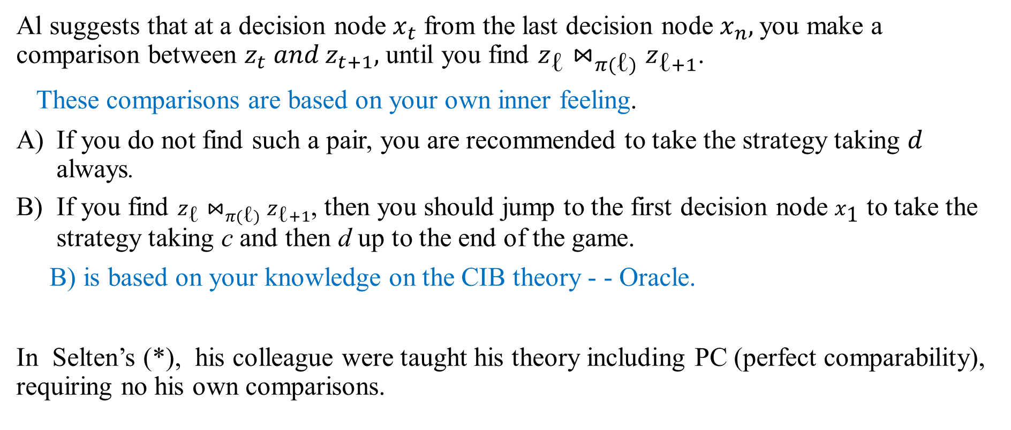
An algorithm with an oracle - - guide for practical behavior
Al suggests that at a decision node $x_{t}$ from the last decision node $x_{n},$you make a comparison between $z_{t} and z_{t+1},$ until you find $z_{\text{ℓ}}⋈_{π(\text{ℓ})}z_{\text{ℓ}+1}$.
These comparisons are based on your own inner feeling.
If you do not find such a pair, you are recommended to take the strategy taking $d$ always.
If you find $z_{\text{ℓ}}⋈_{π(\text{ℓ})}z_{\text{ℓ}+1}$, then you should jump to the first decision node $x_{\text{1}}$ to take the strategy taking c and then d up to the end of the game.
B) is based on your knowledge on the CIB theory - - Oracle.
In Selten’s (*), his colleague were taught his theory including PC (perfect comparability), requiring no his own comparisons.

Slide 23
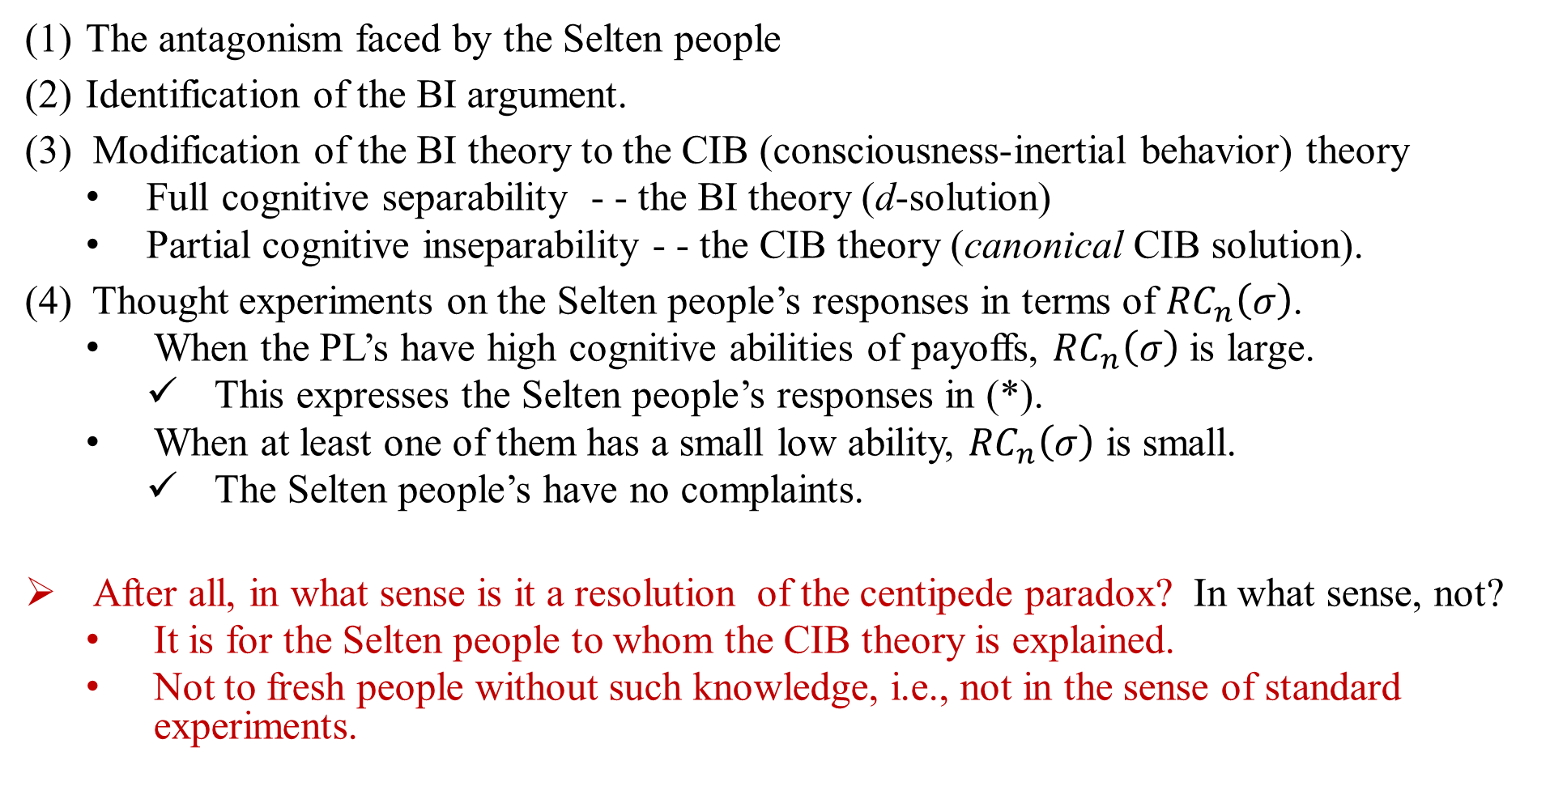
A Resolution of the Centipede Paradox.
The antagonism faced by the Selten people
Identification of the BI argument.
(3) Modification of the BI theory to the CIB (consciousness-inertial behavior) theory
  Full cognitive separability - - the BI theory (d-solution)
  Partial cognitive inseparability - - the CIB theory (canonical CIB solution).
(4) Thought experiments on the Selten people’s responses in terms of ${RC}_{n}\left(σ\right)$.
  When the PL’s have high cognitive abilities of payoffs, ${RC}_{n}\left(σ\right)$ is large.
    This expresses the Selten people’s responses in (*).
  When at least one of them has a small low ability, ${RC}_{n}\left(σ\right)$ is small.
    The Selten people’s have no complaints.
After all, in what sense is it a resolution of the centipede paradox? In what sense, not?
  It is for the Selten people to whom the CIB theory is explained.
  Not to fresh people without such knowledge, i.e., not in the sense of standard experiments.

